Slide 1

AI / ML TRAINING · DAY 4 · PHASE C — DATA ENGINEERING & PREPARATION
Data Cleaning & Preprocessing
Part 1 — Cleaning Messy Data
Data quality · missing values · duplicates · data types · outliers · messy text
Unit U8 · Phase C · Day 4 (preprocessing for ML follows in Part 2)

Slide 2






ORIENTATION
Garbage in, garbage out
The reality: real data is messy — missing values, duplicates, wrong types, outliers and typos. A model is only as good as the data it learns from, so cleaning comes first.
1
2
3
4
5
Assess quality
Missing values
Duplicates & types
Outliers
Messy text
spot what's wrong
detect & handle gaps
dedupe & fix dtypes
find & treat extremes
standardise categories
Recap: U7 got the data in. Now we make it trustworthy before any analysis or modelling.
U8 · Data Cleaning (Part 1)
2

Slide 3
1
ASSESS
Finding the problems
Before fixing anything, profile the data — what's missing, what's malformed, and what looks wrong.
Data Cleaning · Part 1 · Phase C · 01 / 06

Slide 4
Data Cleaning
Data cleaning is the process of preparing raw data by detecting and correcting errors so it can be effectively used for analysis. It is a foundational step in data preprocessing that ensures datasets are suitable for analytical, statistical and machine learning tasks.
Raw data is often noisy, incomplete and inconsistent which can negatively impact the accuracy of the model.
Clean datasets are also important in EDA (Exploratory Data Analysis), which enhances the interpretability of data so that the right actions can be taken based on insights.

Slide 5
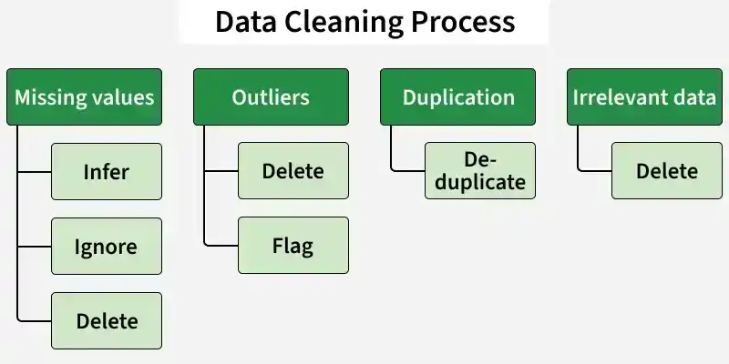
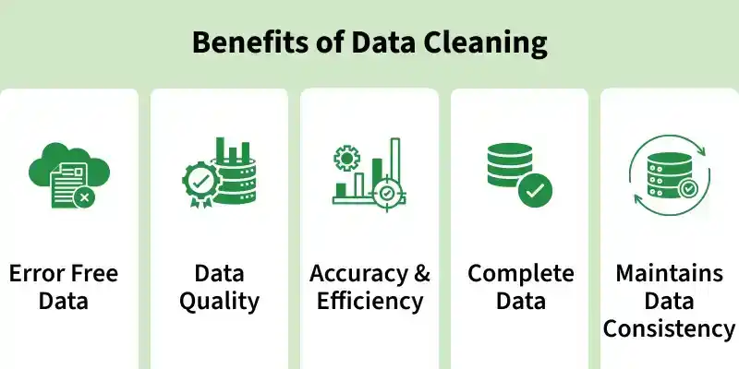

Slide 6
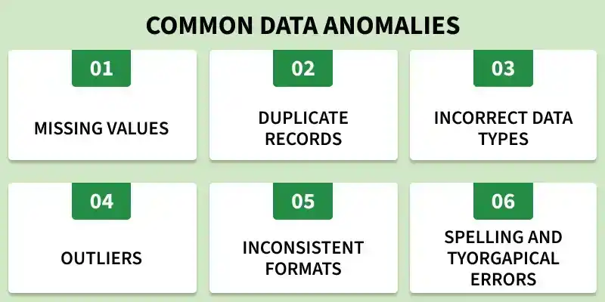
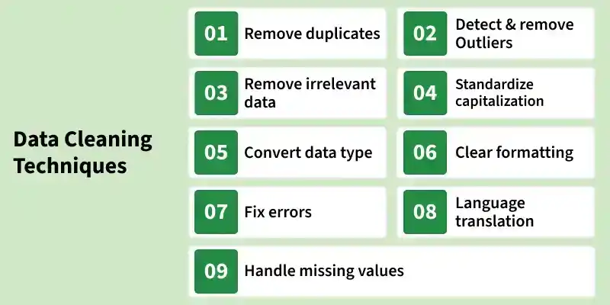

Slide 7




KNOW WHAT TO LOOK FOR
Data-quality dimensions
Completeness
Validity
Consistency
Uniqueness
are values missing?
right type & range?
same thing, same way?
any duplicates?
profile.py
Always profile first
df.info() # types + non-null counts
df.isna().sum() # missing per column
df.describe() # ranges, spot odd min/max
df.duplicated().sum() # duplicate rows
A few commands reveal most problems before you write a single fix.
IN-CLASS LAB Profile a messy dataset: run info(), isna().sum() and describe(); list the problems you find.
U8 · Data Cleaning (Part 1)
4

Slide 8
STEP 1 — FIND THE GAPS
Missing values: detection
Why they appear — not collected, lost, or 'not applicable'
detect_missing.py
import numpy as np, pandas as pd
# treat sentinel values as missing first
df = df.replace(['N/A', '', -1], np.nan)
df.isna().sum() # count per column
df.isna().mean().round(2) # fraction missing
df[df['age'].isna()] # rows missing 'age'
Many disguises — NaN, None, empty string, 'N/A', -1, 999
Count them — df.isna().sum() per column
As a percentage — df.isna().mean() — how bad is each column?
IN-CLASS LAB Count missing values per column and as a percentage; convert sentinel values to NaN.
Half the battle is recognising disguised missing values before they corrupt your stats.
U8 · Data Cleaning (Part 1)
5

Slide 9


STEP 2 — DECIDE WHAT TO DO
Missing values: handling
Drop
Impute
Forward / back fill
Flag
remove rows/cols when data is plentiful or a column is mostly empty
fill numeric with mean/median, categorical with the mode
carry the last value forward — good for time series
add an 'is_missing' column so the model can use the signal
df.dropna()
df.fillna(df.median())
df.ffill()
df['x'].isna()
Median beats mean for skewed columns; never impute the target you're trying to predict.
IN-CLASS LAB Handle missing values three ways (drop, mean-impute, median-impute) and compare the results.
U8 · Data Cleaning (Part 1)
6

Slide 10
2
FIX
Cleaning the data
Now repair what profiling revealed: duplicates, wrong types, extreme outliers and inconsistent text.
Data Cleaning · Part 1 · Phase C · 02 / 06

Slide 11

DEDUPE & RETYPE
Duplicates & data types
Duplicates
fix_dupes_types.py
Repeated rows skew counts & bias models. Find and drop them.
# duplicates
df.duplicated().sum() # how many?
df = df.drop_duplicates()
# data types
df['price'] = pd.to_numeric(df['price'],
errors='coerce')
df['date'] = pd.to_datetime(df['date'])
df['cat'] = df['cat'].astype('category')
df.dtypes # verify the fixes
Wrong data types
Numbers stored as text, dates as strings — convert so maths & sorting work.
IN-CLASS LAB Drop duplicate rows, then convert a text column to numeric and a column to datetime.
U8 · Data Cleaning (Part 1)
8

Slide 12
TAMING EXTREME VALUES
Detecting & handling outliers
IQR rule — outside Q1−1.5·IQR or Q3+1.5·IQR
The IQR rule, drawn as a box plot
Z-score — more than ~3 std-devs from the mean
Then decide — remove · cap (winsorise) · or transform (log)
outlier
Judge, don't delete — an outlier may be the most important signal
whisker = 1.5 × IQR; points beyond are flagged
IN-CLASS LAB Detect outliers in a numeric column with the IQR rule and decide how to treat them.
U8 · Data Cleaning (Part 1)
9

Slide 13
STANDARDISE THE STRINGS
Messy text & inconsistent categories
The same category, written five ways
BEFORE
clean_text.py
" Pune " · "pune" · "PUNE"
"Pune " · "Pune."
s = df['city']
s = s.str.strip() # trim whitespace
s = s.str.lower() # unify case
s = s.str.replace('.', '', regex=False)
# map known variants to one label
s = s.replace({'bombay': 'mumbai'})
df['city'] = s
df['city'].value_counts() # verify
AFTER
"pune" (one clean category)
Inconsistent labels split one real category into many — wrecking counts, joins and encodings.
IN-CLASS LAB Standardise a messy text column with str methods and a value mapping.
U8 · Data Cleaning (Part 1)
10

Slide 14

WRAP-UP
Recap, homework & what comes next
KEY TAKEAWAYS
HOMEWORK / SELF-PACED
UP NEXT — PART 2
Profile the data before fixing anything
Detect missing values — even disguised ones
Drop or impute gaps; flag when useful
Drop duplicates; fix wrong data types
Spot outliers; standardise messy text
Profile a messy CSV and list its problems
Convert sentinels to NaN; count missingness
Handle gaps 3 ways and compare
Drop duplicates; fix a numeric & a date column
Flag IQR outliers; standardise a text column
Encoding categoricals — label & one-hot
Feature scaling — normalise & standardise
Feature engineering basics
Remember: clean data is the highest-leverage work in ML. Time spent here saves far more time debugging models later.
U8 · Data Cleaning (Part 1)
11

Slide 15
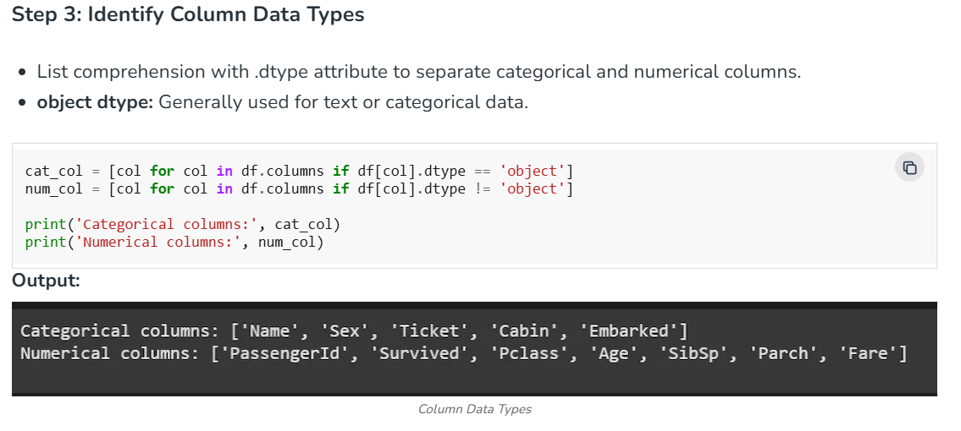
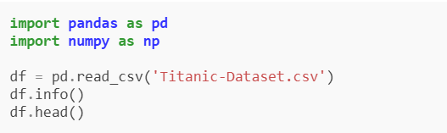
Implementation for Data Cleaning
Let's understand each step for Database Cleaning using titanic dataset.
Step 1: Import Libraries and Load Dataset
We will import all the necessary libraries i.e pandas and numpy.
Step 2: Check for Duplicate Rows
df.duplicated(): Returns a boolean Series indicating duplicate rows.

Slide 16
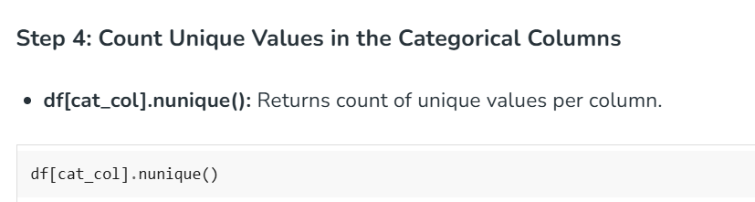
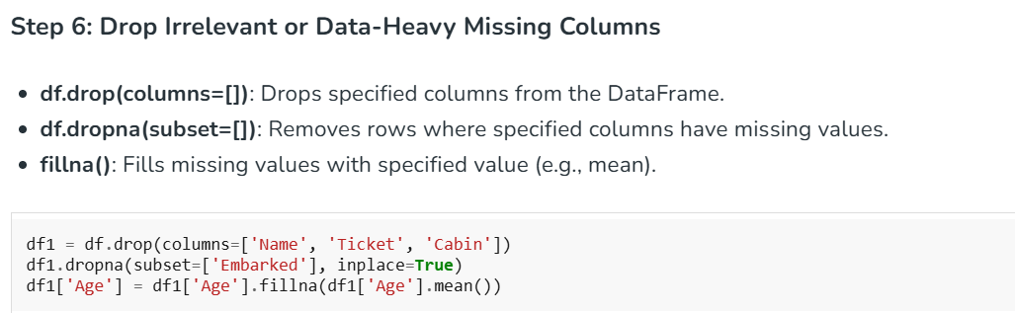

Slide 17
